Slide 1
Applying ML to House Prices in Ames
Shameer Sukha

Slide 2
Data Science Lifecycle
1) Business under-standing
2) Data mining
3) Data cleaning
4) Data explor-ation
5) Feature engin-eering
6) Predictive modelling
7) Present insights

Slide 3
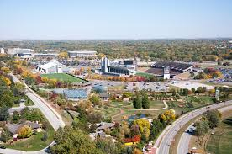
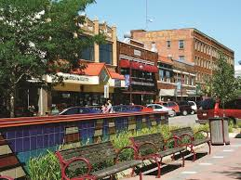

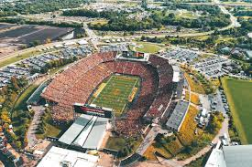


1) Business understanding
Top 100 best places to live
Iowa State University town
Academic, sports, culture
Public parks, open spaces
Good healthcare and jobs
Young population
What about real estate in Ames?
Classic case to apply supervised machine learning

Slide 4
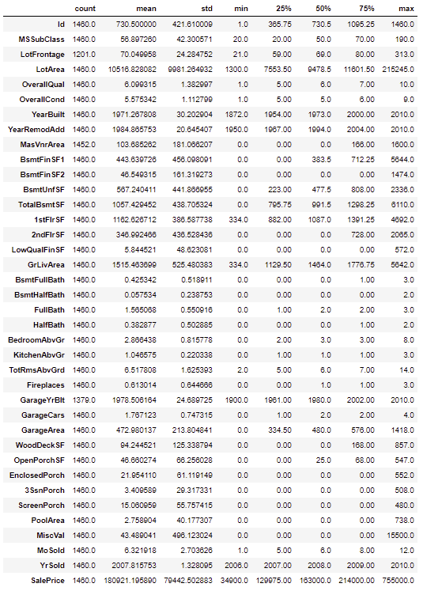
2) Data mining
No need to mine housing data
Kaggle competition
1460 datapoints
79 features
Data types
Categorical
Nominal
- Neighbourhood
- Type of material/condition
Ordinal
- Quality of house
- Quality of finish
Numerical
- Size (area sq. ft)
- No. of rooms

Slide 5
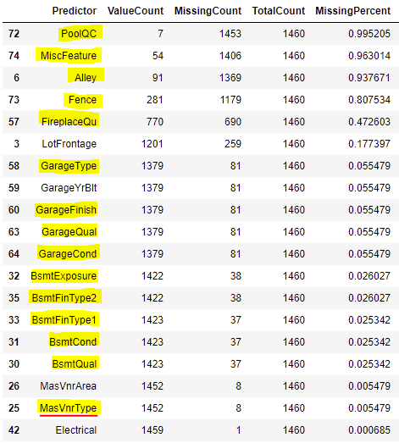
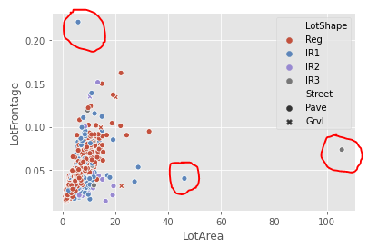

3a) Data cleaning: missing data or errors
Most missing data were Not Missing At Random (NMAR)
Impute with ‘N’
Except MasVnrType (red underline): impute with ‘None’
MasVnrArea
NMAR since houses with MasVnrType = ‘None’ are missing
Impute with 0
Electrical:
Impute ‘Mix’ since only 1 data point missing and won’t be material
LotFrontage:
Appears to be Missing At Random (MAR)
Related to LotArea (which is complete)
Use KNN imputation with k = 35 since outliers are present
BsmtExposure:
Change ‘N’ to ‘No’ since ‘N’ and ‘No’ mean different things
GarageYrBlt:
NMAR: Impute zeros to be YearBuilt
Notes:
Missing because of lack of feature according to the data description.txt

Slide 6
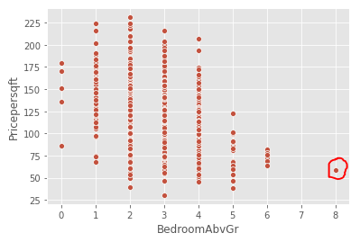
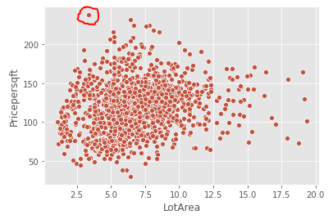
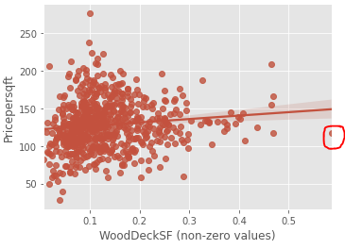
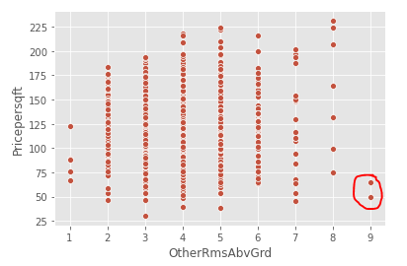
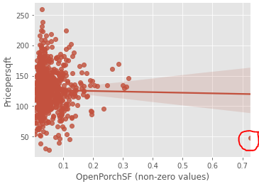
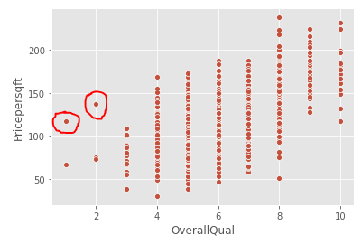
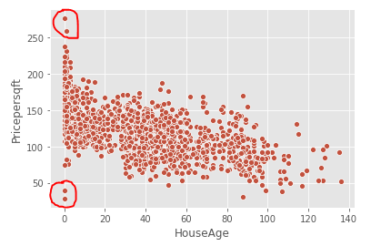
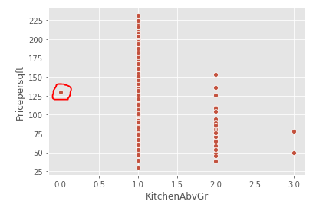
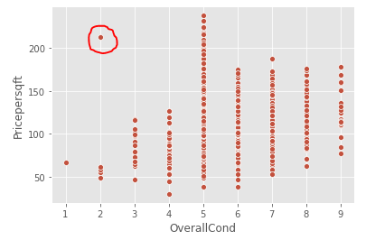
3b) Data cleaning: outliers
OpenPorchSF
Drop 1 record (abnormal SaleCondition) with value >70% of GrLivArea
WoodDeckSF
Drop 1 record that had value >50% of GrLivArea
MiscFeature
Drop 1 record that had tennis court
Drop 2 records that had ‘Othr’ (no explain)
Drop 2 records that had ‘Gar2’
LotArea
Drop 20 records that had lot sizes that are 20 times greater than GrLivArea
Such large lot sizes are likely special cases
HouseAge, OverallCond, OverallQual and SalePrice
Drop 4 records where house age is 0 or 1 year and SalePrice / GrLivArea is greater than 250 and less than 50
Drop 1 record where condition is 2 and SalePrice / GrLivArea > 250
Drop 2 records where quality < 3 and SalePrice / GrLivArea > 100
Drop 1 record with 8 bedrooms
Drop 1 record with 0 kitchens
Drop 2 records with 9 other rooms
Notes:
Linear models are sensitive to outliers
Happy to limit my domain of modelling prediction to mainstream houses.
Special cases should be dealt with separately.
Impossible to have a perfect ML model that predicts perfectly under every scenario
Fine for my model to not predict the price of a house that has 9 bedrooms or lot sizes that are more than 20 times larger than home size!

Slide 7
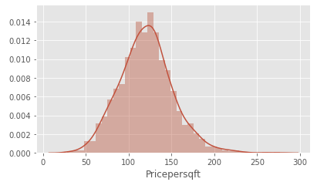
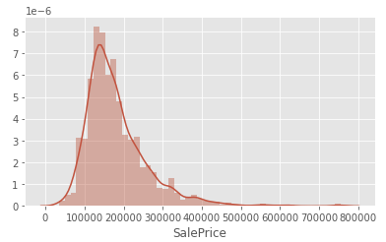
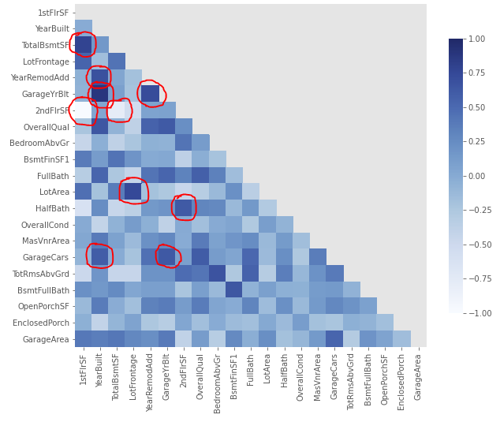
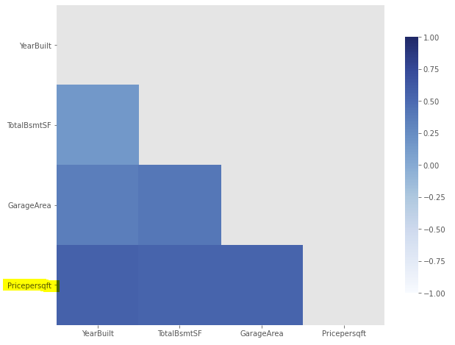
4) Data exploration
34 numerical and 45 categorical
Highly skewed distributions (>9): MiscVal, PoolArea, LotArea, 3SsnPorch, LowQualFinSF (due to many zeros)
SalePrice → Price per square foot
Use GrLivingArea to create ‘Pricepersqft’ (which is much closer to normal distribution)
All area variables → % of house size
Divide all area variables by GrLivingArea, which brings comparability and standardisation benefits
Features correlated with Pricepersqft
YearBuilt, TotalBsmntSF, GarageArea are demonstrating >50% correlation
Multicollinearity is going to be a problem
Top10 pairs are >90% correlated
58 pairs are greater than 70% correlated
Most correlations make sense, e.g. 1stFlrSF/2ndFlrSF, YearBuilt/GarageYrBult, TotalBsmtSF/1stFlrSF, LotFrontage/LotArea, YearRemodAdd/GarageYrBlt
Curse of dimensionality is going to be a problem
Notes:
Some of the numerical are actually categorical in disguise, like MSSubClass or Month. Imbalanced datasets (due to lack of feature) create highly-skewed distributions, better off as categorical?
With linear models, its not so much the feature and target variables that need to be ‘Normal’ or linear. We can still model quadratic or exponential relationships after an appropriate transformation. It’s the residuals or errors that need to satisfy the assumptions of independence, homoscedasticity and normality. However, we can pre-empt issues with residuals, if, for example, the target variable is not normally distributed
SalePrices vary drastically for obvious reasons and the histogram looks ripe for a log transformation. However my idea is to create a new target variable, Price per square foot, which I expect to be more stable and may be a better candidate for predictive modelling than sale price itself. Hence normalise all Area-related variables by dividing by GrLivingArea.
Total Basement size and Garage are highly correlated with Pricepersqft. Those are typically extra costs when a developer is building a community.
Multicollinearity is going to be a problem since many variables contain overlapping information about the house, correlation plot confirms this. Lots of features with ~60% being categorical which explodes dimensions further after one-hot encoding

Slide 8
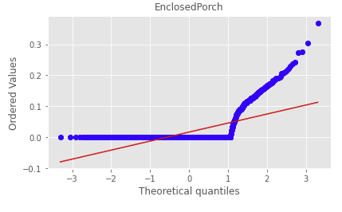
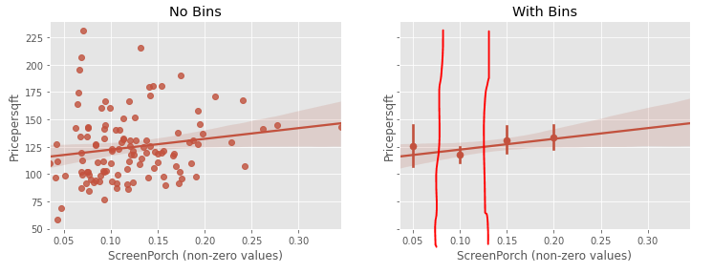
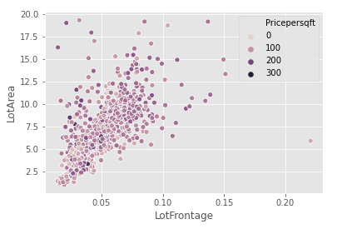
5a) Feature Engineering
Use grid search Lasso before any feature engineering to see test error: 28% (training 15%)
Porch-related
All qq-plots are similar, reflecting highly-skewed distributions due to imbalanced datasets (due to lack of feature)
Convert to categorical variables using bins to identify splits
Drop 3SsnPorch since too sparse
Misc. variables
After dropping tennis court etc, convert to categorical indicating if ‘Shed’ is present
Drop MiscValue
Pool-related
Too sparse, only 6 datapoints so drop PoolArea and PoolQC
Lot-related
Drop LotFrontage since related to LotArea (which is of more interest)
Make LotShape binary Regular or Irregular
Drop Street since only 3 Gravl
LowQualFinSF
Drop since sparse and info likely contained in Overall quality variable
Notes:
Before any feature engineering, take cleaned dataset, use 70/30 train-test split and run grid search Lasso 10-fold cross-validation. Test score is 28%, sets the benchmark for feature engineering
Porch-related variables are imbalanced with ugly elbow-shaped qq-plots. Convert to categorical or drop if very sparse (3SsnPorch). Use binning of variable against Pricepersqft to determine splits.
Dropping tenniscourt and other records, what remains is shed in MiscFeature – convert to binary Shed. Drop sparse variables pool-related and other lot-related like Street, LotFrontage. People care about lot size more than Lot frontage.

Slide 9
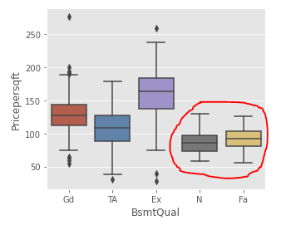
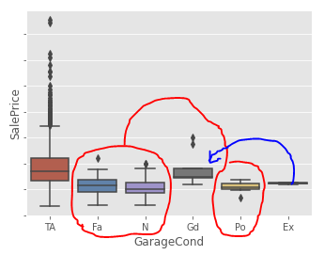
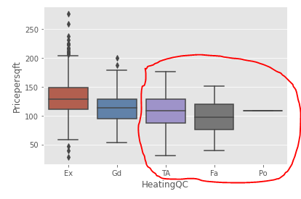
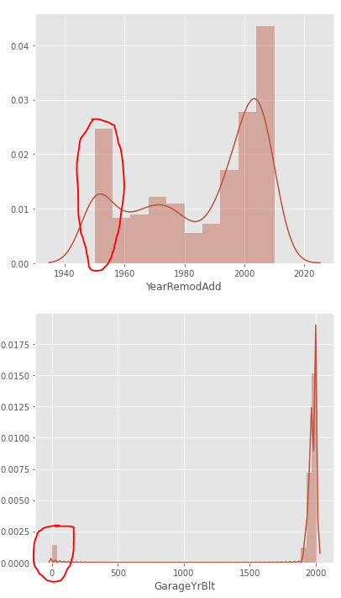
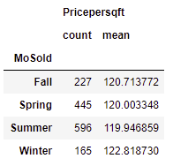
5a) Feature Engineering
Basement-related
Perfect multi-collinearity with basement area variables, drop BsmtFinSF1/2 and BsmtFinType1/2
Consolidate ‘N’ and ‘Fa’ for BsmtQual.
DropBsmtCond and BsmtExposure -- sound like important variables but what matters is size, quality and how much still unfinished
Garage-related
Drop GarageArea since info contained in more interpretable GarageCars
Consolidate GarageCond into 3 categories and GarageType into 4
Drop GarageQual since likely captured in GarageCond and OverallQual
Living area-related
Drop 1stFlrSF since info contained in GrLivArea
Create ‘OtherRmsAbvGrd’ = TotRmsAbvGrd – BedroomAbvGr and drop TotRmsAbvGrd
Fireplaces and Environment-related
Drop Heating, CentralAir and Electrical since too sparse after one-hot encoding
Consolidate HeatingQC and FireplaceQu into 3 categories
Calc age out of Year variables
Drop GarageYrBlt since YearRemodAdd captures this plus more
Create HouseAge = YrSold - YearBuilt
Create RemodAge = YrSold – YearRemodAdd
Sale-related
Consolidate SaleType and SaleCondition into 3 and 4 categories
Convert MoSold into Season variable for the 4 seasons
Notes:
Tackling features by theme to help breakdown the whole feature engineering. Starting to get overwhelming.
Besides dropping sparse or redundant features, realising that I need to consolidate categories.
Need to be ruthless in reducing multicollinearity and dimensionality without losing useful information with predictive power.
Convert Year variables into age. Drop GarageYrBlt since RemodAdd contains this info plus more.
Nothing special about months but perhaps there is something to seasons so convert month to season.

Slide 10
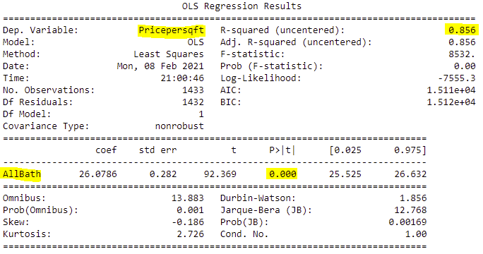
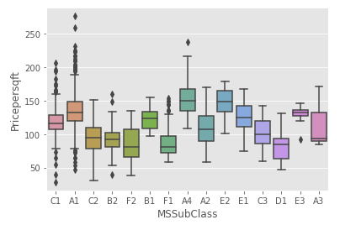
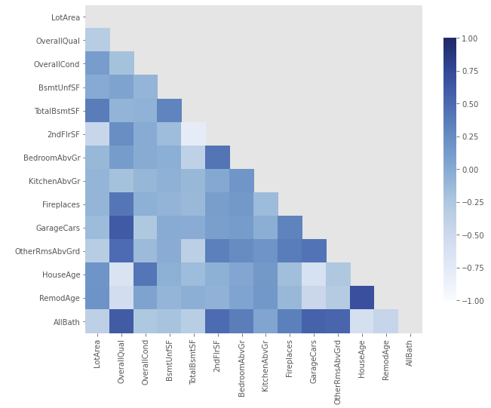
5a) Feature Engineering
Exterior-related
Drop Fence, Foundation, Exterior2nd, Exterior1st, RoofMatl, RoofStyle since not much explanatory power
Consolidate Functional, ExterCond and ExterQual into 4, 3 and 3 categories respectively.
Drop MasVnrArea since MasVnrType has more explanatory power
Land-related
Drop Landslope, Utilities and LotShape since no explanatory power
Drop Condition2, Alley, LandContour and LotConfig since sparse or low explanatory power likely only creating multicollinearity
Consolidate Condition1 railroads and positive features into single category
Bathroom-related
Create AllBath = 2*FullBath + 1.5*Halfbath + 1*BsmtFullBath + 0.5*BsmtHalfBath
Drop all bath features retaining single one
Manually reduced 79 features to 37.
Use grid search Lasso again to check impact: test error = 20% (train 16%)
Have reduced multicollinearity and dimensions and appear to have gained some explanatory power.
Notes:
Aaaargggh, I’m getting bored and tired now (similar to how I feel about this pandemic)!
Consolidate Bathroom info into single variable with relative weights for importance.
MSSubClass numerical may mess things up with the model since it’s actually categorical in disguise. May be opportunity for consolidating categories but nothing obvious.
Wow, feature engineering is hard. Surely there is an easier, more efficient, more automated solution to deal with this? Unfortunately, I think the answer is ‘No’ because this is where step 1 comes in, i.e. understanding the data and the business context. So why did I send 80% of my time on Feature Engineering? Albeit tedious, I see it as a necessary investment in understanding the data that will help with modelling and insights.
I used my original grid search Lasso as a compass for guiding my feature engineering (to minimise my risk)
Whew, managed to reduce 79 features to 37 and consolidate categories for some. Correlation charts looks better but still some correlation (although less than before). I’m going to place some trust into regularization to help reduce the variance of any model applied to this data.

Slide 11
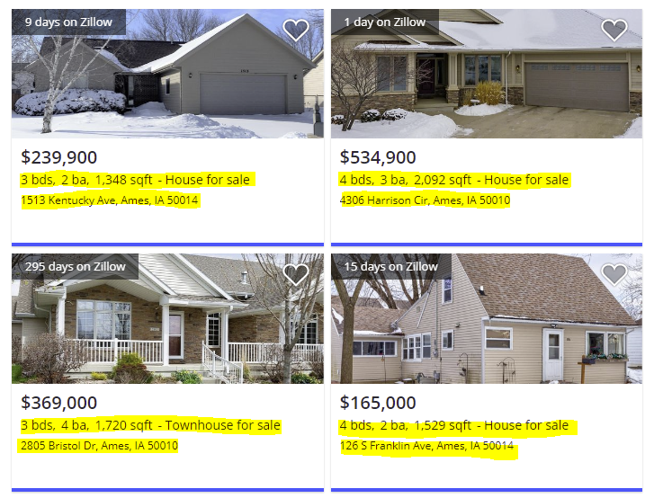
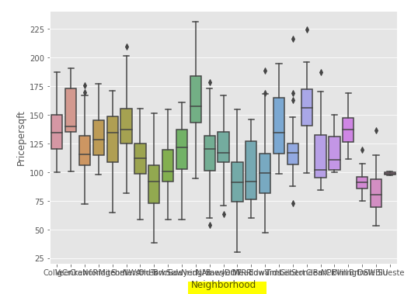
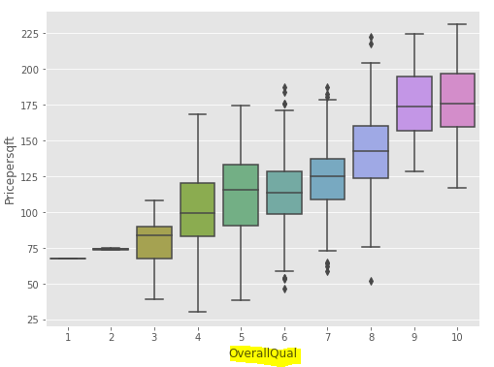
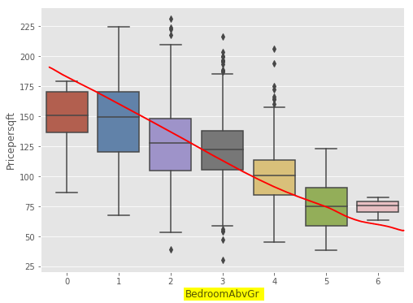
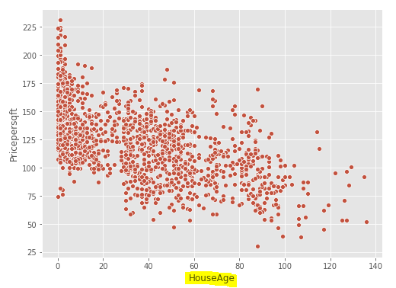
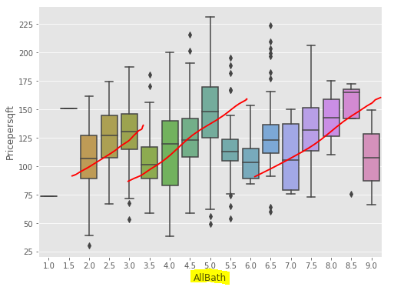
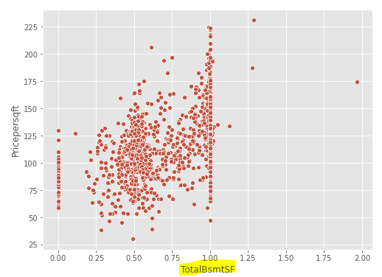
5b) Feature Selection
What do I think are important features?
Any Realtor/ Real-estate site / common-sense says:
Neighbourhood
House Type
# Bedrooms
# Bathrooms
Size of house
However, that is for predicting SalePrice
What about [Sale Price per sq. ft]!
If building 3 or 4 bedroom house, it can still make sense for cost to be $120 per sq. ft
Average/Median cost is $120 with min $30 and max $230 (std dev 30)
So what would really differentiate Price per sq. ft?
Neighbourhood
House age
Overall quality
Size of basement?
Notes:
The first level of feature engineering broke the problem down into parts. Taking a bird’s eye view, what do I think are the important features?
Neighbourhood, House type, size of house, # bedrooms, # bathrooms. However that is Sale Price.
What about Pricepersqft? Definitely Neighbourhood, House age, overall quality, size of basement?
Bedroom appears counterintuitive at first, but actually makes sense in for Pricepersqft – seems to demonstrate the Law of Diminishing Returns. See-saw pattern for Bathroom also looks wrong at first, but makes sense given that the Basment bathrooms are adding to the Pricepersqft.

Slide 12
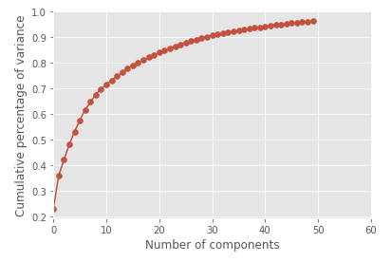
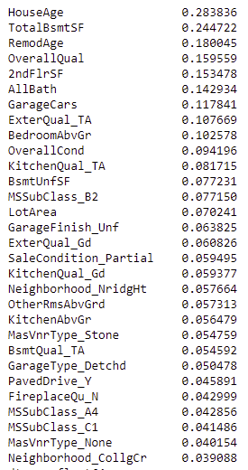
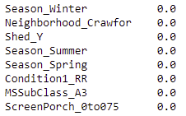
5b) Feature Selection
Check PCA
First 10 components explain ~70%, first 20 ~83% and first 30 about 90% of the variance amongst all features
Check Mutual information
Mutual information doesn’t work well for small sample sizes (<1000) and/or high dimensionality so don’t place too much weight yet
Future exploration: Stability selection using Lasso learner (Meinshausen & Bühlmann 2010)
Ready to apply machine-learning models!
✓
✗
?
Notes:
What about selecting features more objectively?
Use One-Hot encoding for categorical features with drop_first=True
Scale numerical variables by subtracting mean and dividing by std. dev
Mutual information is an information entropy-based test, which generalizes correlation in a non-linear manner. Information entropy is useful for tree-based models.
It apeears that HouseAge, TotalBsmtSF, RemodAge, OverallQual, 2ndFlrSF, AllBath and GarageCars are top features, which is intutitvely correct
- It appears Season doesn’t really have an effect

Slide 13
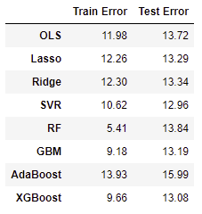
6) Predictive Modelling
Train-Test split
Hold-out 30%
Use 70% for training
Hyper-parameter tuning
Grid-search
Stratified K-fold cross-validation with K=10
Root Mean Square Error (RMSE)
Gives error in units of Pricepersqft ($)
Feature Importance
Understand which features are important
Standard Scaling
Normalise features by subtracting mean and dividing by std. dev
Supervised Learning
Regression
Regularization
Instance-based
Ensemble
Ordinary Least Squares
Ridge
Lasso
Support Vector Regression
Random Forest
Gradient Boosting Machine
AdaBoost
XGBoost
Stochastic Gradient Boost
Notes:
I wanted to run all applicable models that I knew because pushing data through models is the easy part! OLS serves a benchmark. I was happy to see that residual diagnostics passed assumptions of linearity, normality, independence and homoscedasticity.
Scaled all features because it will help comparisons. Use 70/30 train test split and grid-search cross-validation. Also use RMSE as metric so errors are in Dollar terms. Finally I checked Feature Importances to help understand the differences between models.

Slide 14
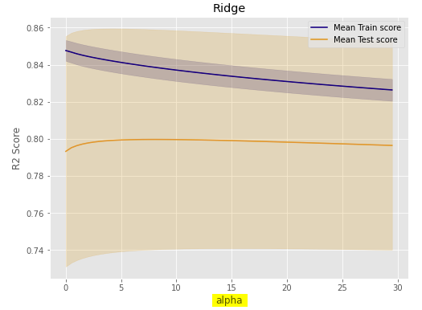
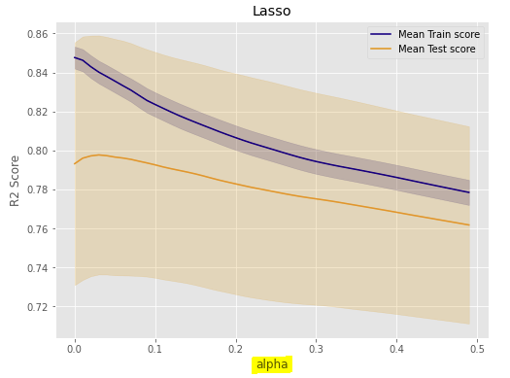
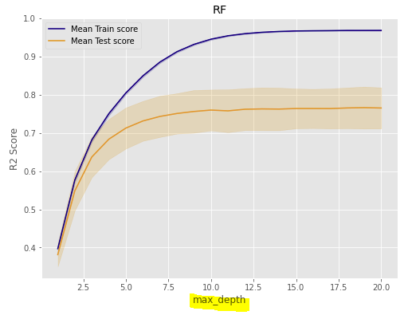
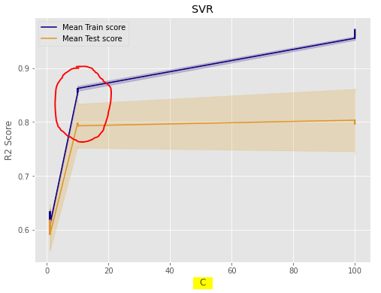
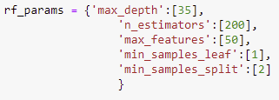

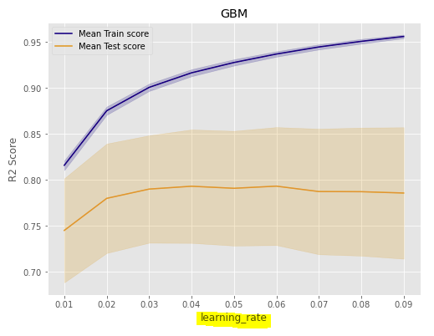
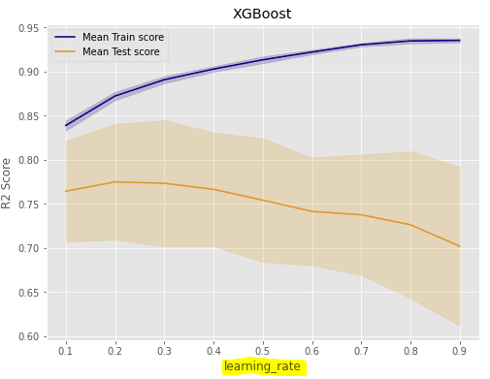
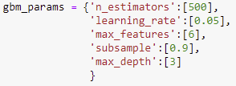
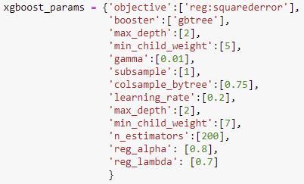
6) Predictive Modelling
Model Bias
Model Variance
Gridsearch with 10-fold Stratified cross-validation helps to prevent overfitting
Hyperparameter tuning:
parameters that directly control model complexity by introducing regularization/cost term (alpha, C, gamma)
Injecting randomness to make training robust to noise (subsample, colsample_bytree)
Still work to be done to reduce overfitting, although there must exist some ‘irreducible error’ in this problem
$13 per sq. ft is not bad considering that 5% commission/legal cost could explain about $5-7 and other factors (like desperate seller/buyer) influencing the price.
Notes:
Clearly there is still overfitting going on evident from holdout Test errors being higher than Training errors. Any application of machine learning algorithms to predictive modelling requires an appreciation of the Bias/Variance trade-off. For example, within linear models, the general OLS has lowest training error but has the highest error on unseen data. Regularization from Ridge and Lasso models increase the bias (higher train scores) but reduce the variance of the model (lower errors on test data). Ridge/Lasso have the lowest difference in error from all models at around $1.00. AdaBoost appears to be the worst based on test error.
More complex models (SVR, Random Forest, GBM) generally have lower training errors relative to test errors, and can easily overfit, so hyperparameter tuning is important. I used manual gridsearch tuning a subset of hyperparameters at a time. For future work, I would like to try the random based grid search, which may optimise better. Learning curve plots can help understand the learning dynamics of a model i.e. the bias/variance tradeoff by changing parameters. It is important to understand which parameters help with the bias/variance trade-off and their impact. For example, there are some parameters like Ridge/Lasso’s alpha, SVR’s C and gamma that directly control model complexity by tuning the cost function associated with the objective function. There are also parameters like subsample that inject randomness to make to make training robust to noise. It is easy to grasp the single parameter for Ridge and Lasso but is more challenging to understand the suite of XGBoost parameters (most from all of the tested models here).
The mean and median Pricepersqft is around $120, with minimum around $30 and max around $230. I think I’m comfortable with an ‘irreducible’ error around $13 because it is impossible to perfectly predict the house price with the given features. There are still a few elements that are not captured, for example commission/legal costs (if that was 5% of house price, that explains about $5-7), things like distressed/desperate seller and general sentiment. In Finance speak the bid/offer for house prices is very wide compared to the bid/offer of the USD/CAD Foreign Exchange rate (for e.g.). I also understand now how Kaggle competition focusing purely on predictive power can lead to the wrong behaviour and approach to data science in general.

Slide 15
7) Present insights
OLS | Lasso | Ridge | SVR
SaleType | HouseAge | HouseAge | HouseAge
SaleCondition | TotalBsmtSF | TotalBsmtSF | TotalBsmtSF
HouseAge | OverallQual | OverallQual | OverallQual
TotalBsmtSF | BsmtUnfSF | BsmtUnfSF | LotArea
BsmtUnfSF | OverallCond | OverallCond | BsmtUnfSF
LotArea | LotArea | LotArea | BedroomAbvGr
OverallQual | SaleType | KitchenQual | OverallCond
OverallCond | KitchenQual | BedroomAbvGr | GarageCars
KitchenQual | BedroomAbvGr | Functional | KitchenAbvGr
Functional | ExterQual | ExterQual | OtherRmsAbvGrd
Which model should I select?
Test score in conjunction with feature importance
The AdaBoost model could easily be dismissed based on test scores!
However, it’s the only model that has MSSubClass and Neighborhood in the top 10
I understand why Boosting techniques have become popular - Ensembling weak learners into a strong learner makes sense (AdaBoost puts more weight on difficult instances)
Future work:
Spend more time training AdaBoost
Develop waterfall chart showing make-up of average sale price per sq. ft
Develop interactive dashboard to understand make-up of sale price per sq. ft (will help with remodelling/renovations and comparison to builder costs)
RF | GBM | AdaBoost | XGBoost
TotalBsmtSF | TotalBsmtSF | TotalBsmtSF | TotalBsmtSF
HouseAge | LotArea | HouseAge | HouseAge
OverallQual | OverallQual | LotArea | OverallQual
BsmtUnfSF | HouseAge | OverallCond | OverallCond
LotArea | BsmtUnfSF | BsmtUnfSF | BsmtUnfSF
OverallCond | OverallCond | OverallQual | LotArea
BedroomAbvGr | 2ndFlrSF | BedroomAbvGr | BedroomAbvGr
ExterQual | BedroomAbvGr | Functional | Functional
2ndFlrSF | Functional | MSSubClass | OtherRmsAbvGrd
RemodAge | RemodAge | Neighborhood | 2ndFlrSF
Notes:
Overfitting should not be confused with model selection, we generally choose a predictive model based on its out-of-sample performance. In this case SVR and XGBoost are strong candidates. And AdaBoost as the worst.
This makes sense if we want the model that makes skillful predictions. However we need to be mindful of the expense of the most skillful model in terms of time, computational resources and model interpretability.
Does the model make sense? This is where feature importance can help. Sklearn has feature_importance built-in functions for tree-based models but not for linear models and SVR. Use permutation feature importance which is model agnostic and judges performance by measuring decrease in score when a single feature is randomly shuffled. The effort put into feature engineering seems to have paid off. Top features are consistently HouseAge, Basement size and unfinished percentage, Overall Quality and lot size. OLS and Lasso have some features that may not actually be that important like SaleType and SaleCondition. Wow, AdaBoost is the only model that has MSSubClass and Neighbourhood so I’m not throwing it out just yet.
I also understand why XGBoost is becoming very popular amongst the data science community as well as Kagglers. It is being labelled as the ‘queen’ of machine learning models. It has the most flexibility i.t.o. tuning parameters (including those to enhance computation time) and can be extended across different platforms.
For future work, I would like to spend more time tuning AdaBoost, develop waterfall charts showing average make-up of house price per sq. ft and finally develop an interactive dashboard that allows a user to test various scenarios. Could be useful for remodelling/renovations against builder costs.

